Slide 1




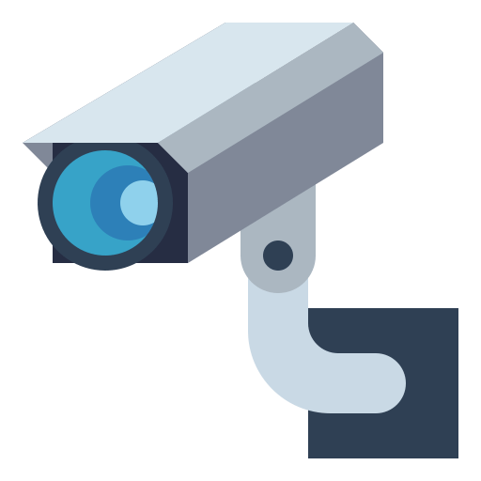
P.S. No- 6 : System for Geo-Tagging of privately Surveillance
Cyberknights (472)
Team Members & Leader:
Krishna Kumar(leader) (UI/UX)
Abhishekh Kumar Singh : Software Development (Website)
Ashish Kumar Mishra : AI/ML.
Gaurav Kumar : Project Flow Developer.

Slide 2

PROBLEM?
Geo tagging for Privately Surveillance
-Utilizing the resources of privately owned cameras to enhance public security through mutual benefits.
CYBERKNIGHTS

Slide 3
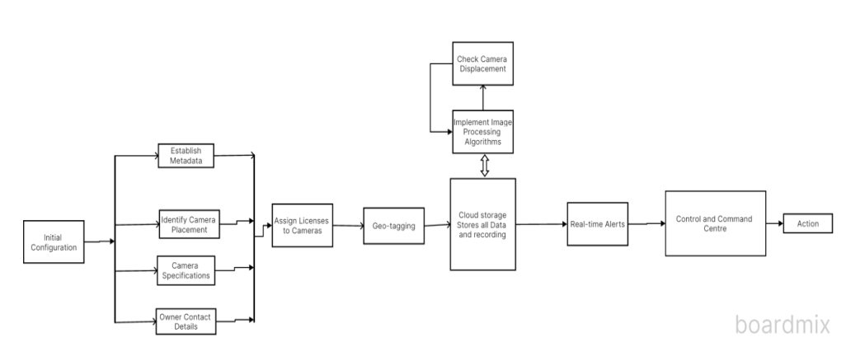
PROJECT FLOW
CYBERKNIGHTS

Slide 4
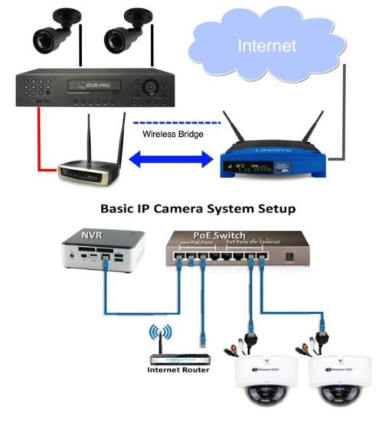
CAMERA INFRASTRUCTURE
DVR & NVR Cameras
IP CAMERAS
CYBERKNIGHTS

Slide 5
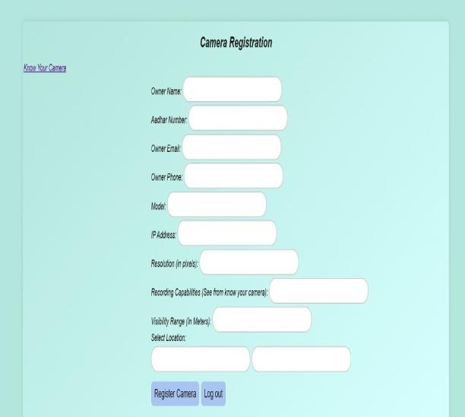
REGISTRATION PHASE
Implement GPS tagging for each camera
By linking their external (static) IP with the location coordinates for precise location information.
Using ONVIF (Open Network Video Interface Forum).
Field of view FOV
CYBERKNIGHTS

Slide 6
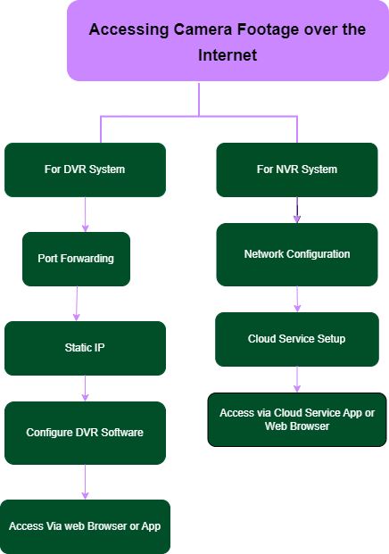
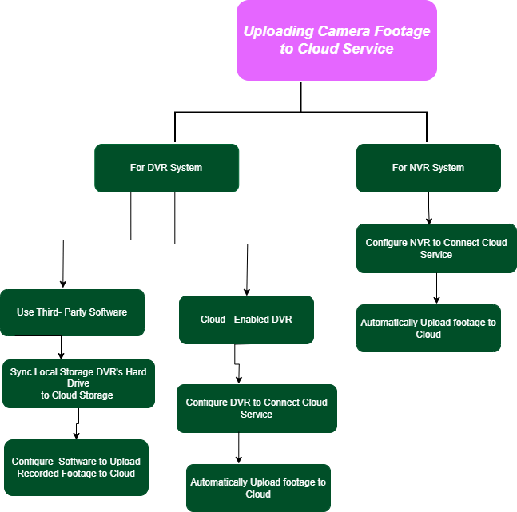
ARCHITECTURE

Slide 7
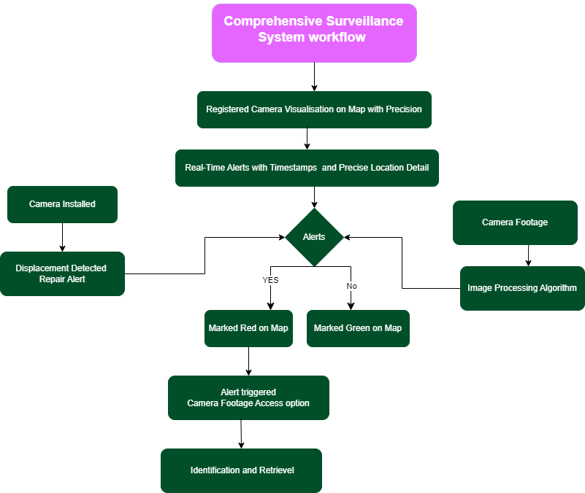
Project flow

Slide 8
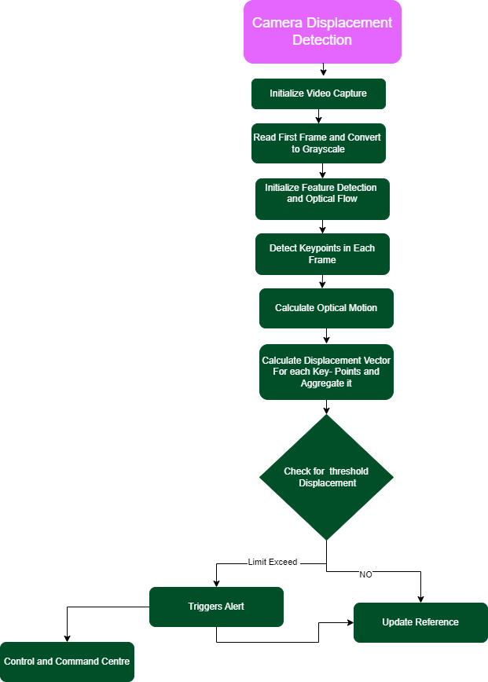
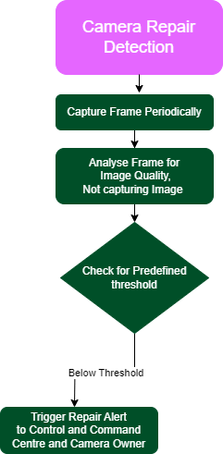
CAMERA DISPLACEMENT
LICENCE NUMBER
RP-DIST-YYYY- NNNN

Slide 9

Demo

Slide 10
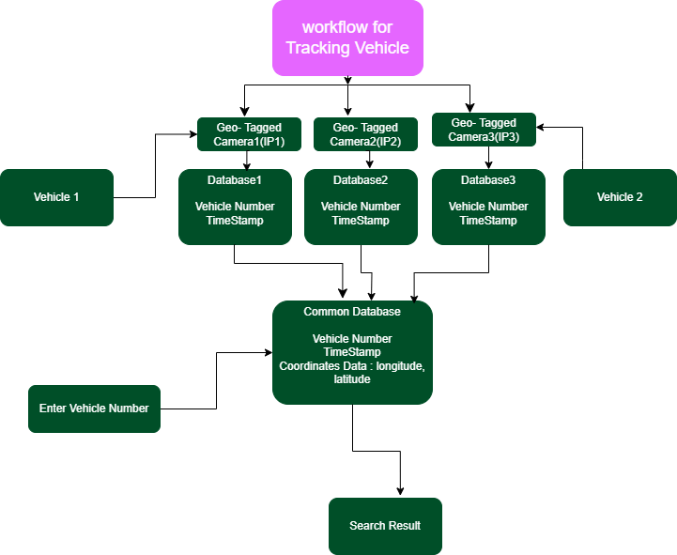
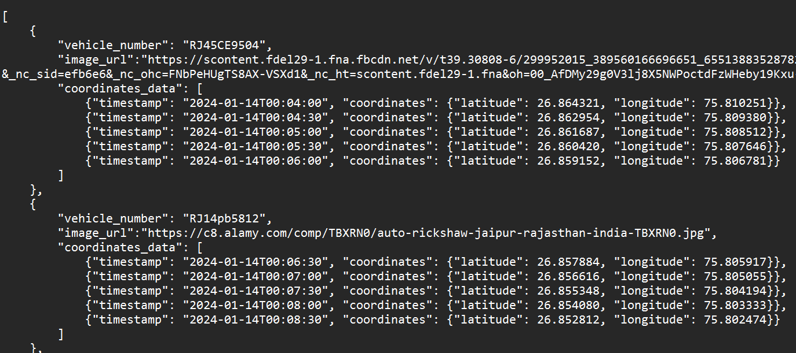

Slide 11
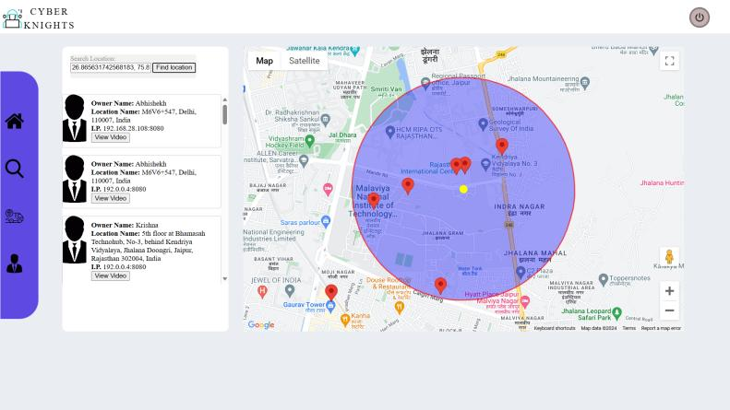
Suspect Tracking

Slide 12
ML model Current problems & our solution

Slide 13
Future Plans
Integration with Vehicle Geo-Tagging System of Rajasthan Police:
Benefits:
Real-time tracking of vehicles could aid in crime prevention and investigation.
Stolen vehicle detection and recovery could be significantly improved.
Traffic monitoring and management could be enhanced.
Reduction of blind spots in the surviellance

Slide 14
Future Plans
Data Analysis of High Crime Regions:
Focus areas:
Identifying socio-economic factors contributing to crime in specific regions.
Analyzing crime patterns and trends over time.
Assessing the effectiveness of existing crime prevention measures.
Potential applications:
Developing targeted interventions based on specific factors contributing to crime.
Allocating resources more effectively to address high-crime areas.
Evaluating and improving overall crime prevention strategies.

Slide 15
Future Plans
Collaboration with other stakeholders like government agencies, NGOs, and community leaders could be crucial for successful implementation.
Transparency and accountability in data usage and decision-making processes are essential to maintain public trust.
Continuous monitoring and evaluation of the project's progress and impact are necessary for ongoing improvement.

Slide 16
Thank You
-TEAM CYBERKNIGHTS
RGIPT- Jais

